Slide 1

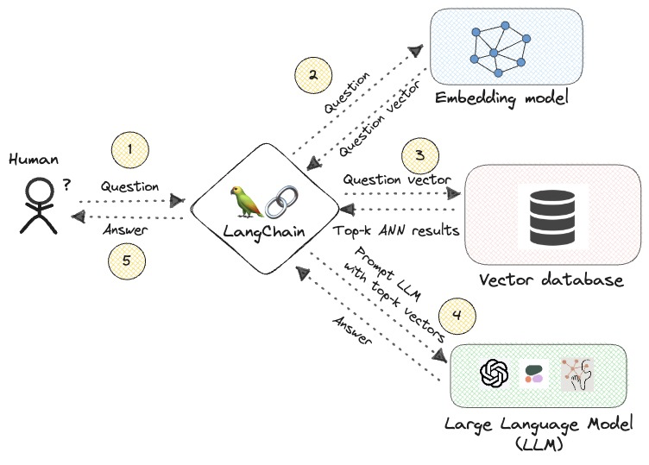
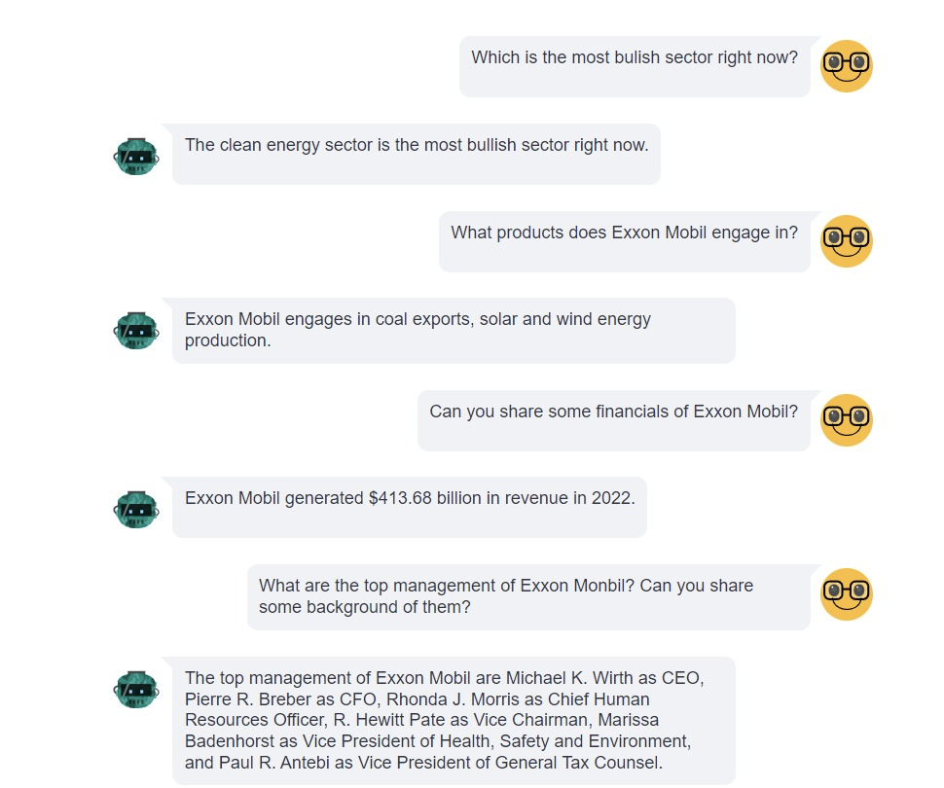
FinBuddy Abhishek Panchal, Divyarajsinh Gohil, Aana Khanduri, Dev Thakkar
Business Intelligence & Analytics
Introduction
Due to the utter lengthiness of Financial documents and news we have devised a Chatbot that assists its users to go through data and assist them with ratio calculations. Our project helps Keep them updated with latest news and reduces time and analysis and data collection by being single source of data.
Results and Model Architecture
Methodology
Our project, Finbuddy, utilizes a sophisticated chatbot interface developed using TensorFlow to engage with users and comprehend their inquiries related to financial documents. It integrates OpenAI's API to efficiently summarize and analyze financial data, making the chatbot a centralized source of updated financial information. The methodology encompasses four main steps:
Initially, the chatbot receives queries from the users.
It then processes these queries to determine specific information needs.
It utilizes the OpenAI API to fetch and condense relevant financial documents and news based on the user’s input and additional metadata.
The bot the presents this streamlined data back to the users, including essential financial ratios and updates.
This approach reduces the time required for data analysis and enhances the accessibility of complex financial information, thereby supporting fast & informed decision-making.
Data & Scope
For this project we have curated the data researching about the energy sector. We have referred to reliable sources like Yahoo Finance and Bloomberg Terminal.
As a proof of concept this bot can help its user to gain information about energy sector like the overall trend of the sector, financials of the companies in this sector, information about the government initiatives in this sector and lot more.
Conclusion
Created an interactive, beginner friendly and suitable for professional use chatbot that helps reduce time in analyzing financial documents and allows people with no background to make sound financial decisions.
Future Scope
Connect the data with Bloomberg/Yahoo Finance to get a single source of truth and premium data and insights.
Introduce text to speech and speech to text capabilities to enable verbal communication with the bot.
http://www.stevens.edu/school-business/masters-programs/business-intelligence-analytics

